Slide 1
Overview of single top physics in CMS with Run-1 data
Rebeca Gonzalez Suarez
University of Nebraska, Lincoln
2d of March 2015
EPFL Lausanne

Slide 2


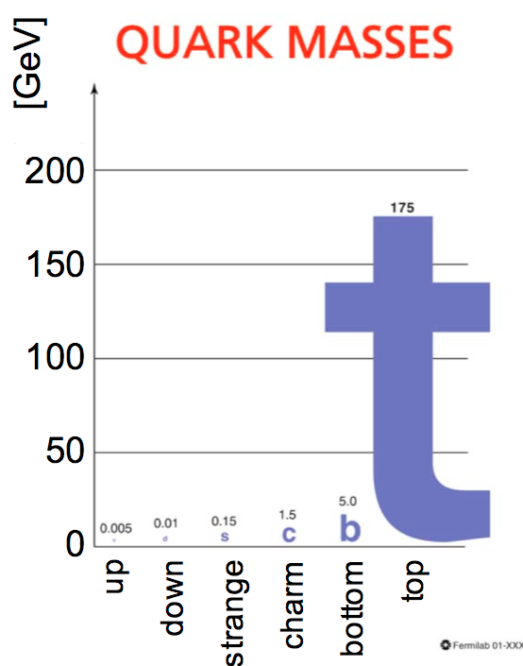


Last Tuesday
Last Tuesday was the 20th anniversary of the discovery of the top quark

Slide 3
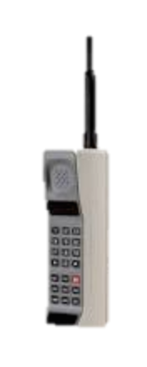

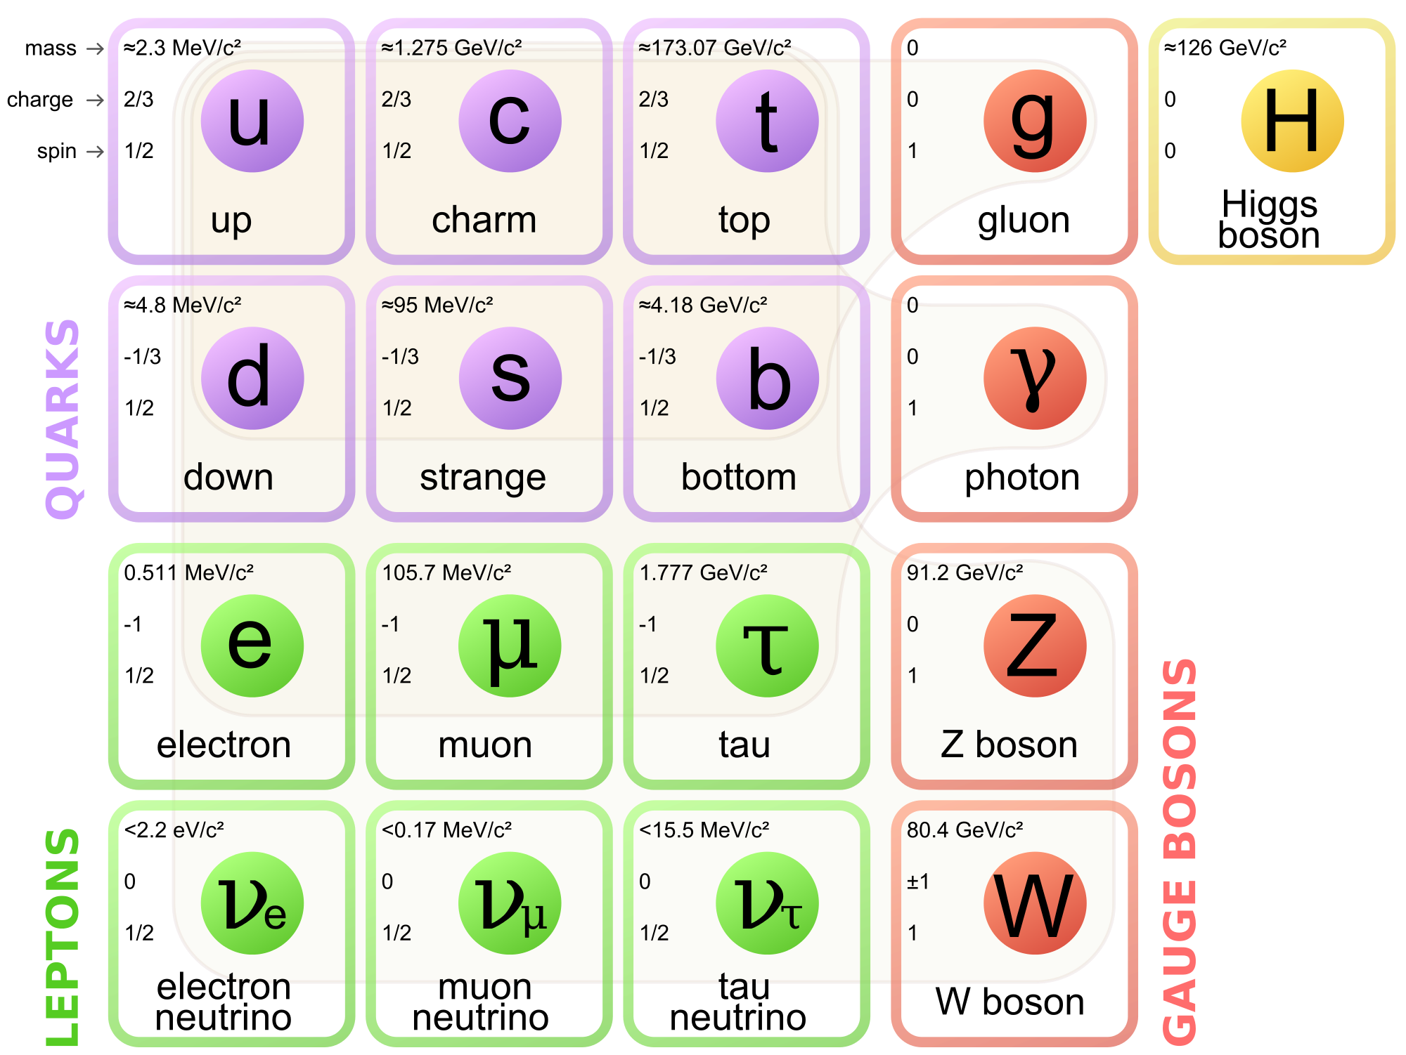
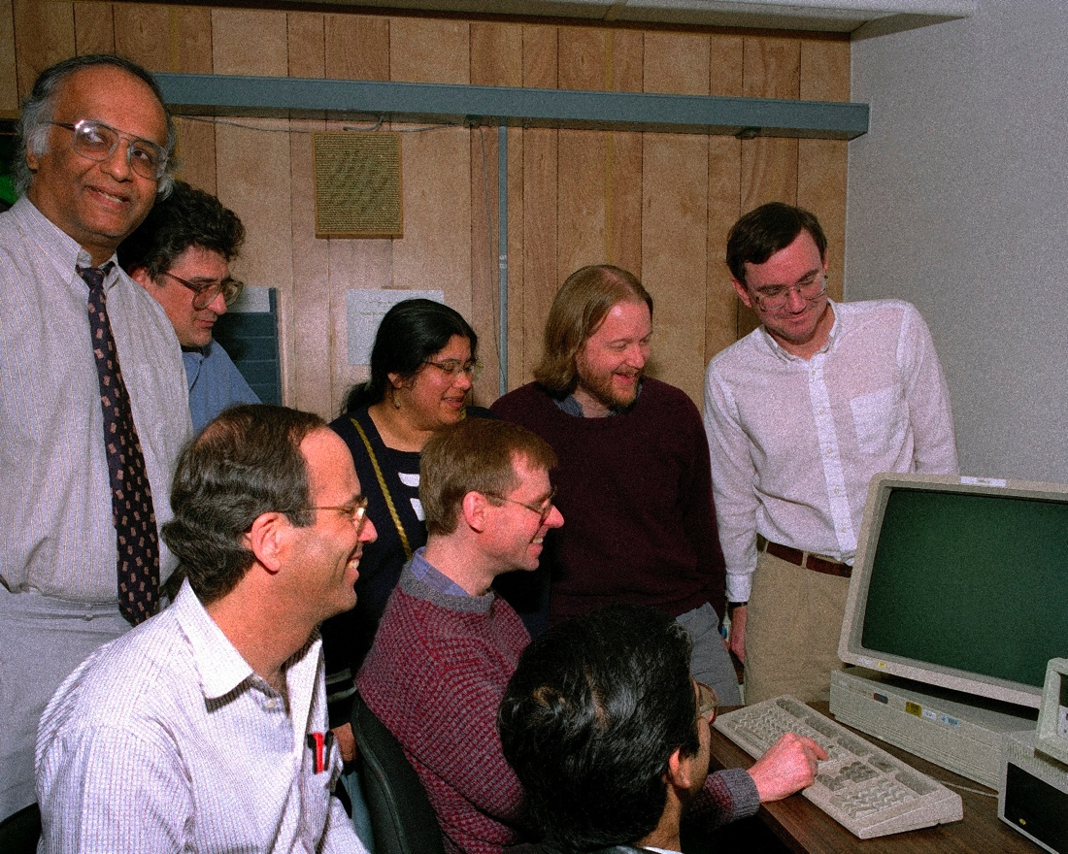
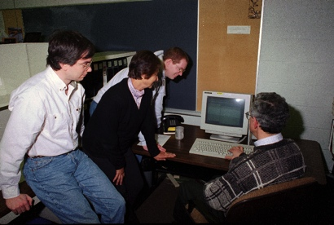
Feb. 24, 1995
On Feb. 24, 1995 the two Tevatron collaborations, CDF and DZero, submitted their Top Discovery papers to PRL:
PRL 74, 2626–2631, PRL 74, 2632–2637
The quark family picture was completed exactly 6 months before Windows 95 was released
And I was 13 years old…

Slide 4

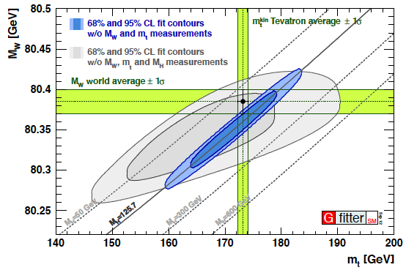
The top quark
Tevatron legacy has been of central importance
In 20 years we are getting to know the top quark really well
It is the heaviest elementary particle known
m_{top} = 173.34±0.27(stat)±0.71(syst) GeV
arXiv:1403.4427
Short lived → only quark that decays before hadronizing
direct access to properties (spin, charge, polarization…)
Has a strong coupling to the Higgs boson
It is a good candidate to play a role in many scenarios of physics beyond the SM (BSM)
Experimental signature:
Decays almost exclusively as t→ Wb

Slide 5
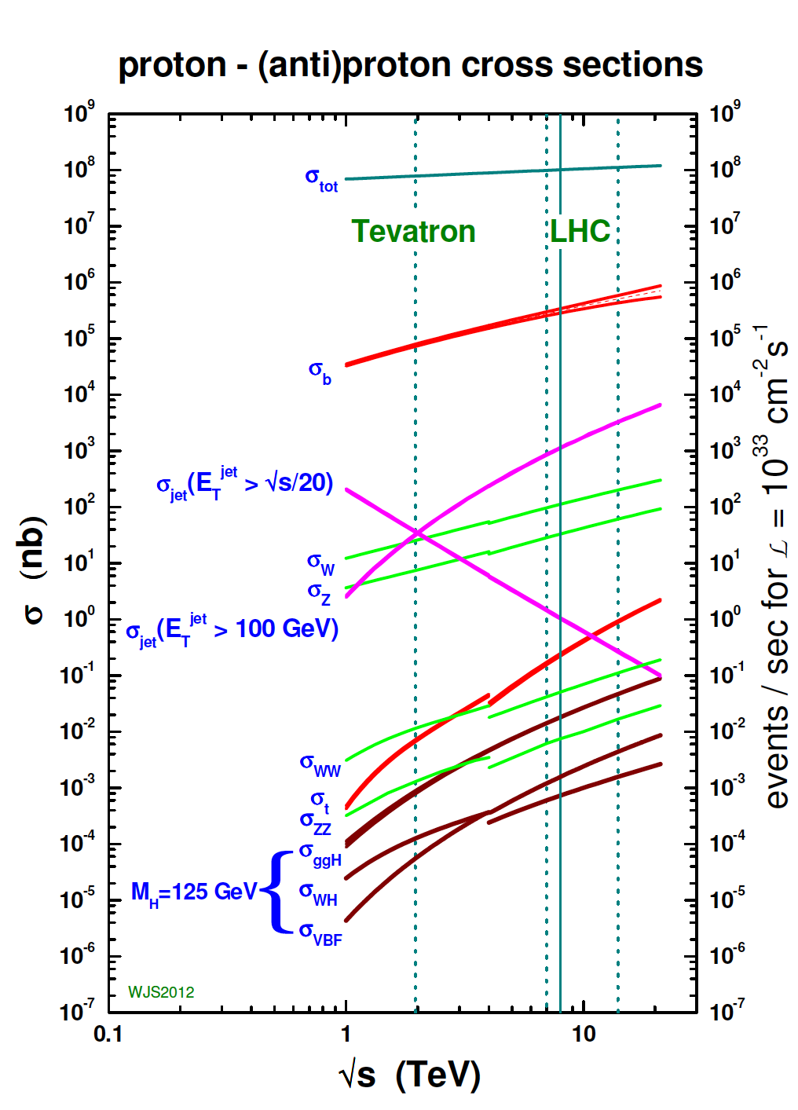
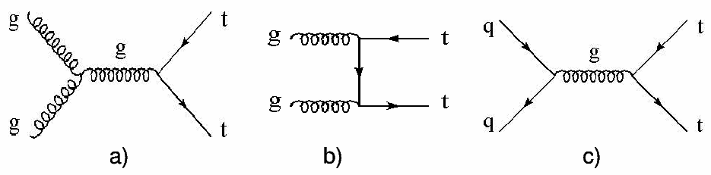

Top quarks at the LHC
At the LHC top quarks are produced at a very high rate
Main mode: ttbar pairs, via strong interaction
x-sec (pb) | ttbar
Tevatron | 7.08 (+0.00-0.24) (+0.36-0.27) approx. NNLO
LHC @ 7TeV | 163 (+7-5)(±9) approx. NNLO
LHC @ 8TeV | 234 (+10-7)(±12) approx. NNLO
t
t
t
t
“The LHC is a top quark factory!”

Slide 6
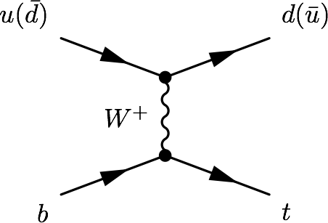
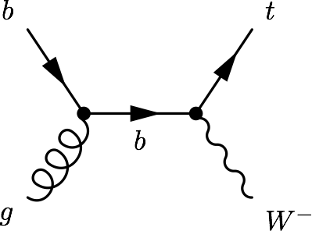
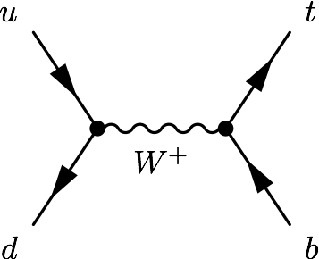
Single top production
There is an alternative mode, at a much lower rate: Single top quark production
Via electroweak interaction, involving a Wtb vertex
Three main process: t-channel, tW associated production, s-channel
σ [pb] | t-channel | tW | s-channel
Tevatron (1.96 TeV) | 2.08 | 0.22 | 1.046
LHC (7 TeV) | 63.9 | 15.7 | 4.63
LHC (8 TeV) | 84.7 | 22.2 | 5.55

Slide 7
Single top timeline
1986
Tevatron starts colliding
Single top quarks were also observed at the Tevatron, in March 2009
ATLAS and CMS presented their first t-channel studies with 7TeV data early 2011
Since then, all the main modes have been studied, the t-channel has been used to measure SM properties, and several single top related signatures have been used to study new physics
PRL103:092002, PRL.103:092001
1995
Top quark discovery
CMS-PAS-TOP-11-021, ATLAS-CONF-2011-088
2009
Single top discovery
“The LHC is a SINGLE top quark factory!”
2010
LHC starts colliding
2011
First single top results at the LHC

Slide 8
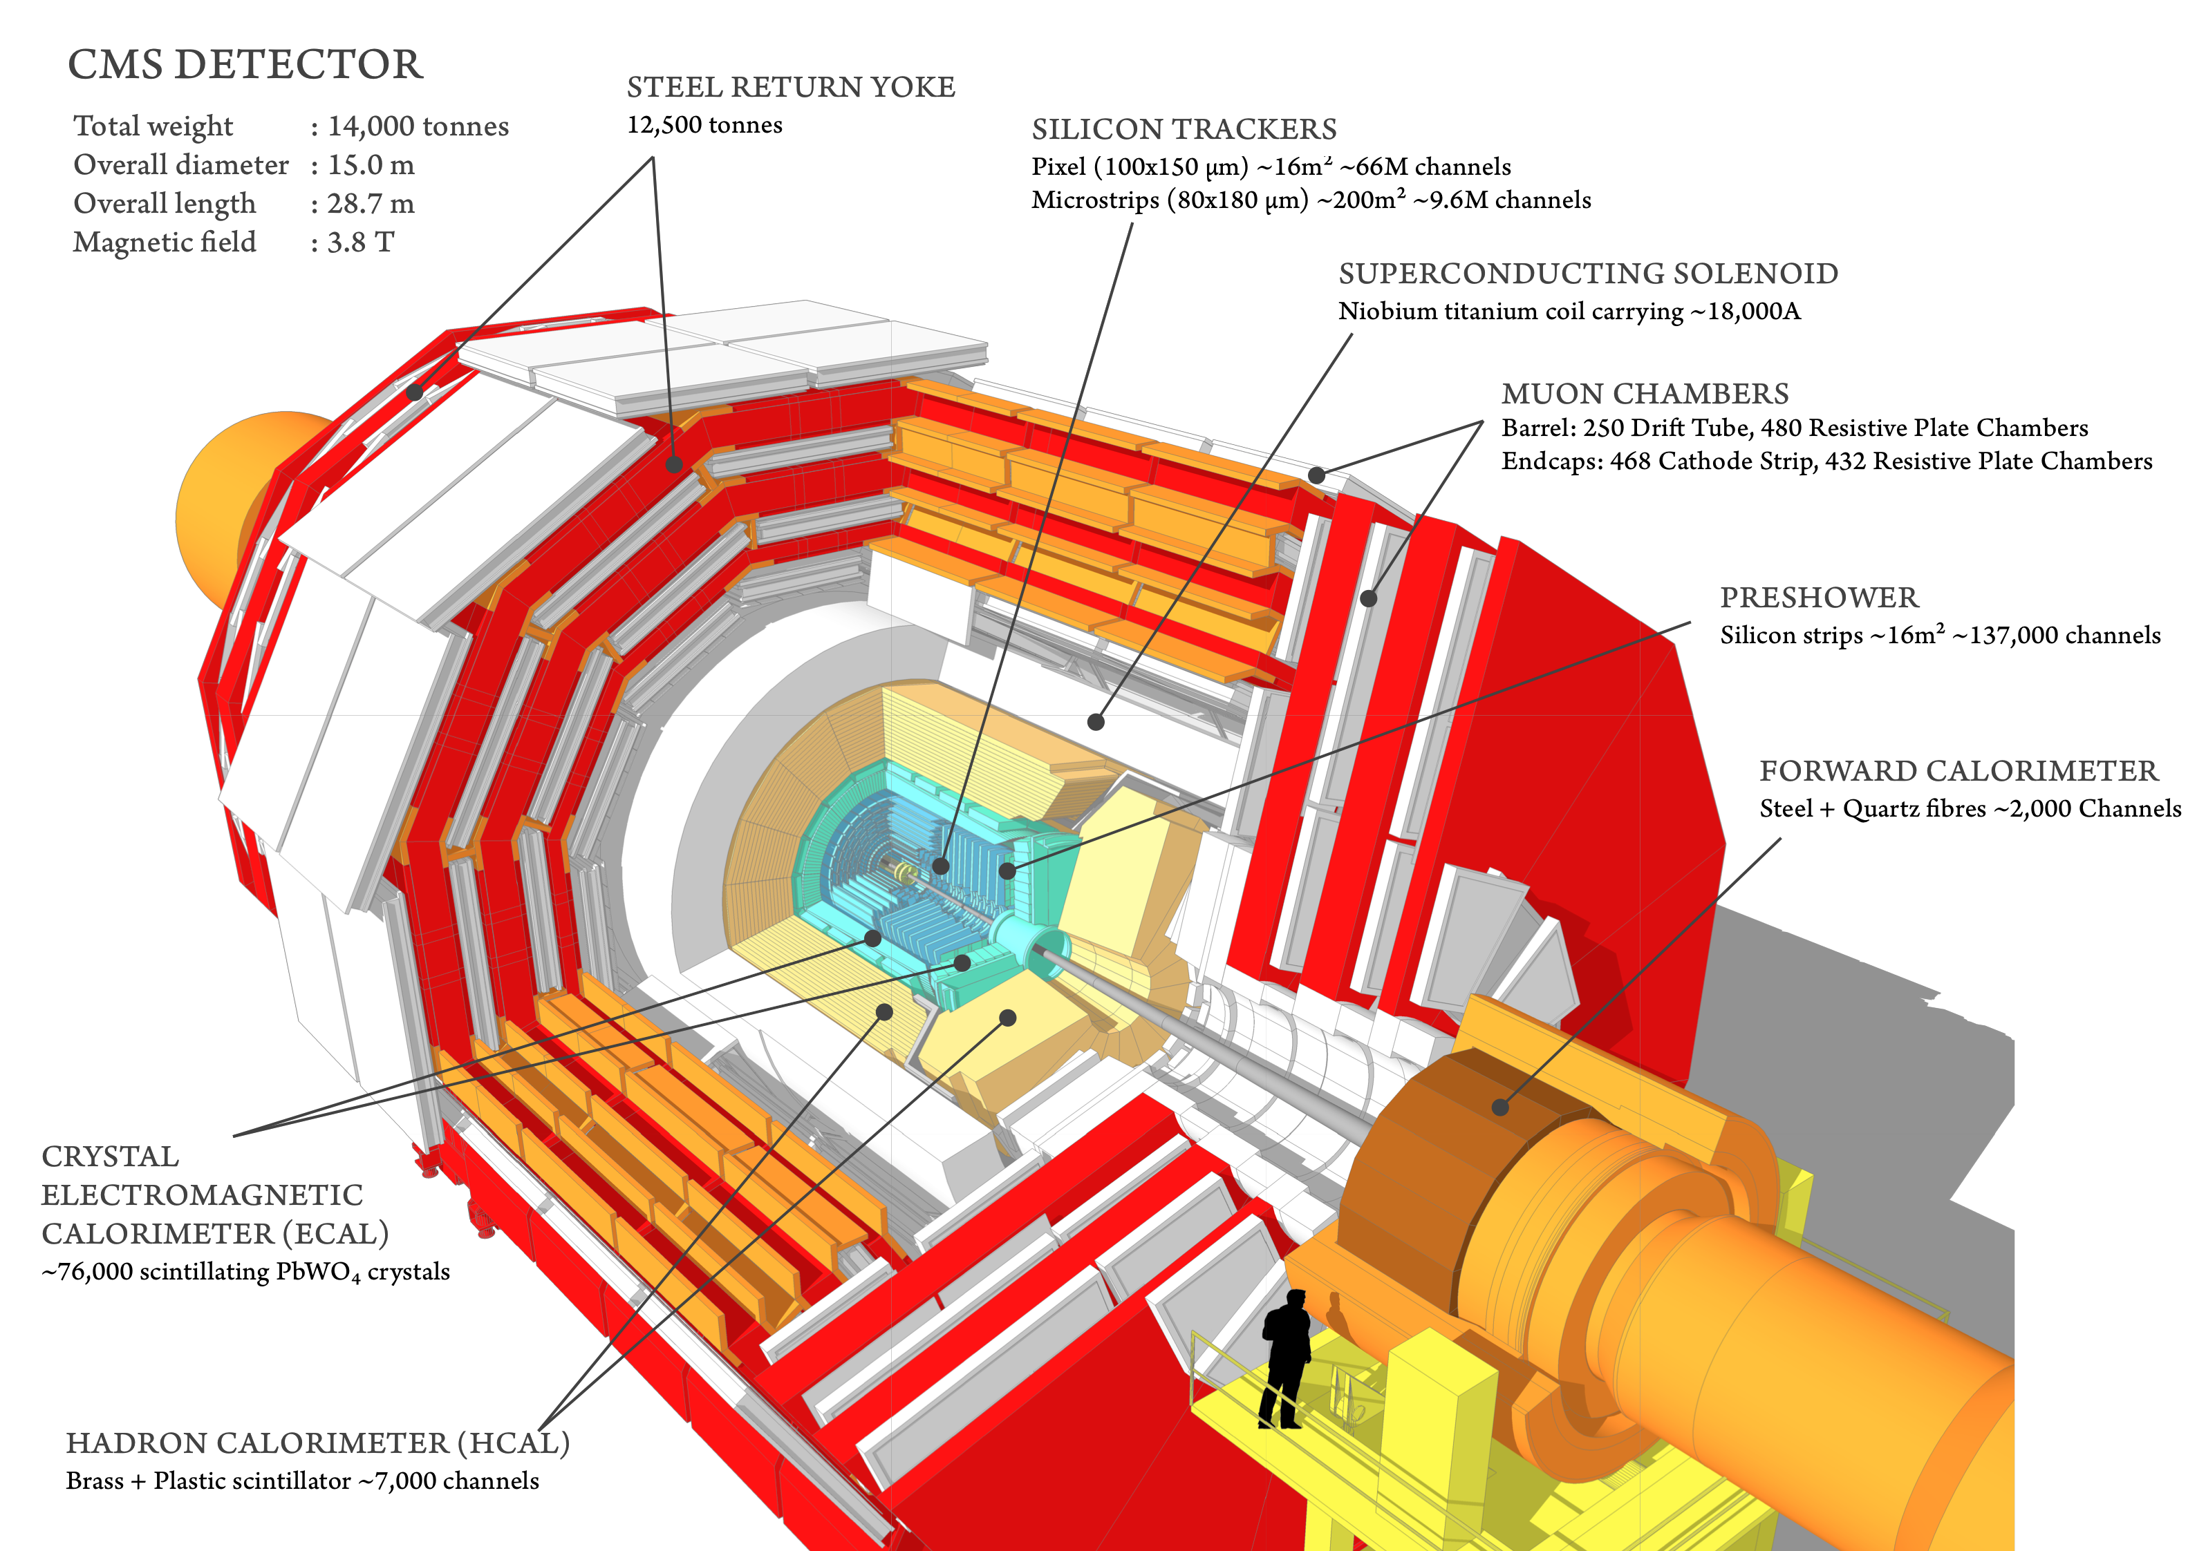
Compact Muon Solenoid (CMS)
Compact Muon Solenoid (CMS)
Total weight : 14,000 tonnes
Overall diameter : 15,0 m
Overall length : 28,7 m
Magnetic Field : 3.8 T
More than 2,600 people
41 countries

Slide 9
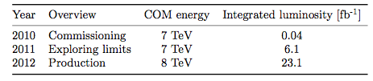
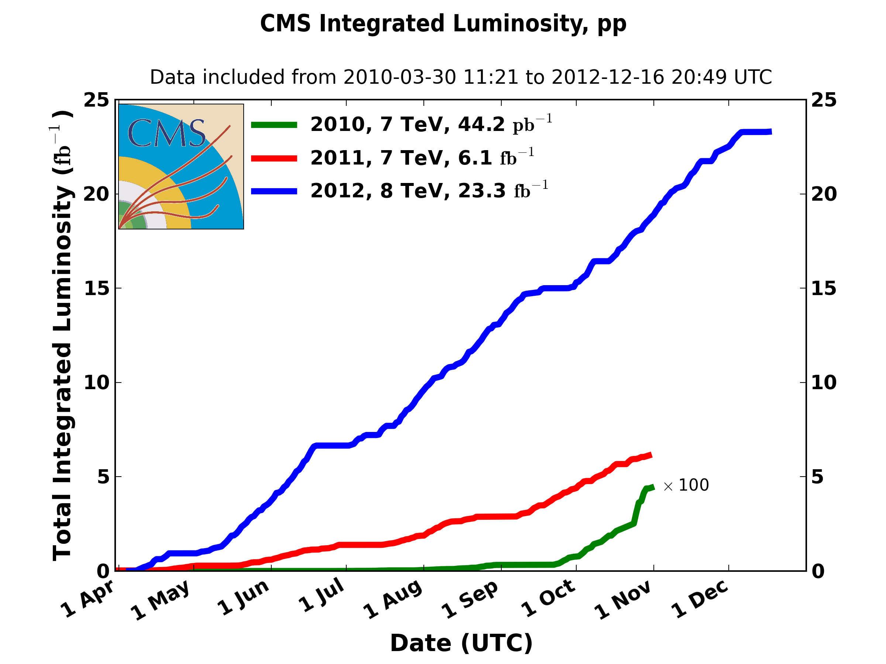
Run-1 in tops
The Run-1 of the LHC started in March 2010 and ended in February 2013
During three years: ~5fb⁻¹ of pp collisions at 7TeV and ~20fb⁻¹ at 8TeV
This means that CMS has recorded:
More than 5M ttbar pairs
Around 2M of single top quarks (via t-channel)
And also:
Half a million of tW events and a bit more than 100K of s-channel events
What have we done with them?

Slide 10
Step 1
Study the three single top production modes and measure their production cross section

Slide 11
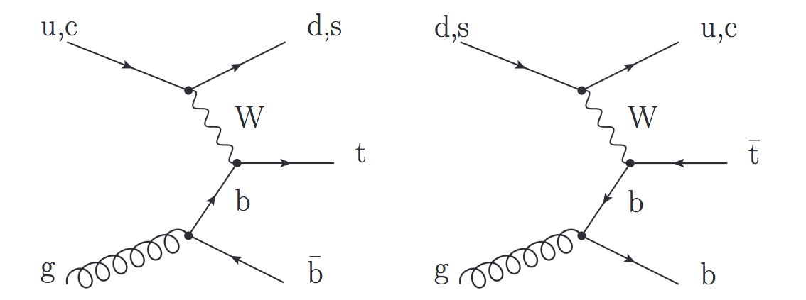
t-channel
Dominant process with the highest cross section at the Tevatron and the LHC
The final state studied is a lepton + jets signature
Signal events characterized by:
One isolated muon or electron
Missing transverse energy (MET)
A central b jet
light-quark jet from the hard scattering process (often forward)
Additionally, a second b jet produced in association to the top quark
Main backgrounds: W+jets, ttbar, multijet
Leptonic top decay

Slide 12
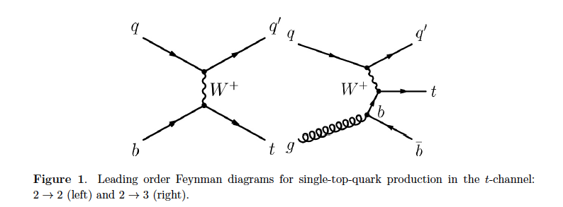
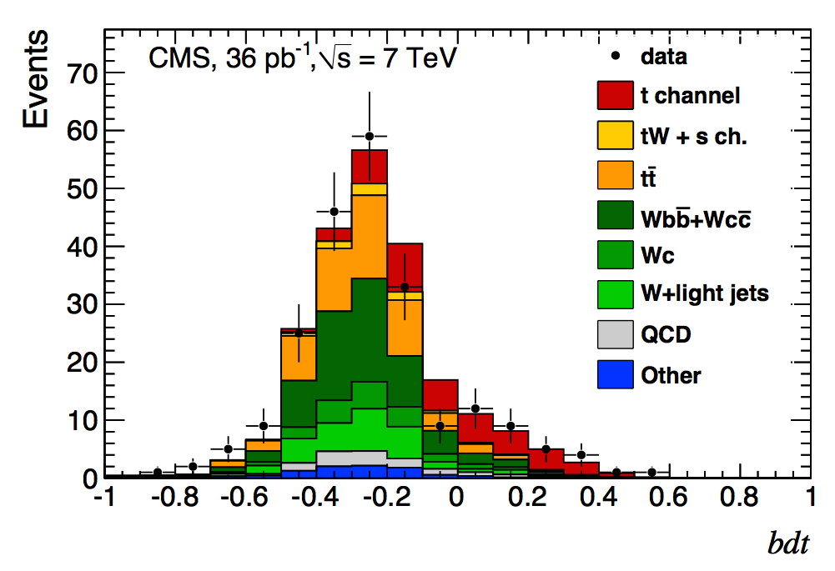
t-channel
Before the start of the Run-1
only t-channel production was observed at the Tevatron
In 2011, barely a year into collisions, CMS published its first t-channel paper
Jun 2011
Phys. Rev. Lett. 107:091802,2011
arXiv:1106.3052
t-channel
36pb⁻¹
2D shape analysis (cosθ* η_{j’}) and BDT
In one year, power to explore processes that took the Tevatron decades

Slide 13
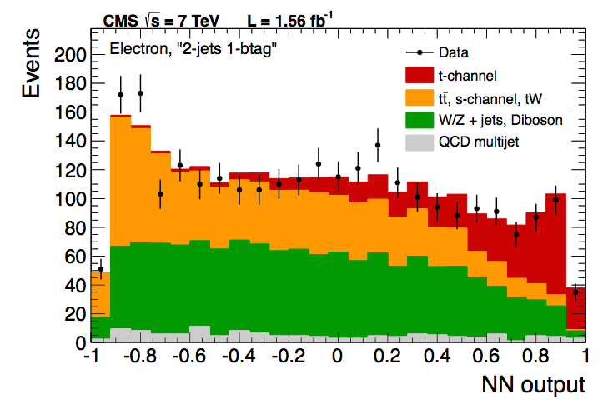
t-channel (7TeV)
At 7 TeV CMS measured the inclusive t-channel cross section
Using Multivariate methods (BDT, NN) and the shape of the pseudorapidity of the light jet, |η_{j’}|
Different regions defined (jets, b-tag)
Multijet and W+jets background estimated from data
Statistical, systematic, and theory uncertainties on the same level
September 2012
JHEP 12 (2012) 035, arXiv:1209.4533
t-channel (|η_{j}|’, NN, BDT)
7TeV - 1.17 and 1.56 fb⁻¹

Slide 14
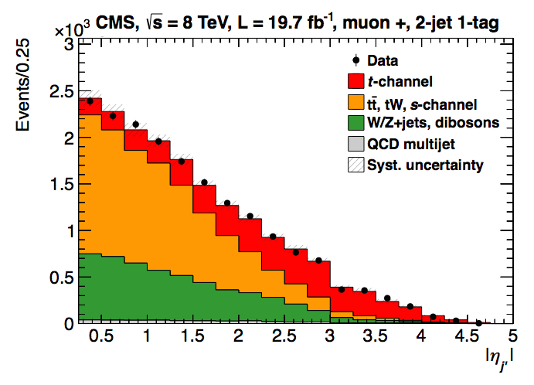
t-channel (8TeV)
At 8 TeV, this was made just with the |η_{j’}| analysis
Similar approach as for 7TeV, more data-driven (Multijet, W+jets, ttbar)
Full luminosity
Systematic dominated
main uncertainties:
Signal modeling (~6%)
and JES/JER/MET (~4%)
March 2014
JHEP 06 (2014) 090, arXiv:1403.7366
t-channel, η_{j’}
8 TeV - 19.7fb⁻¹

Slide 15
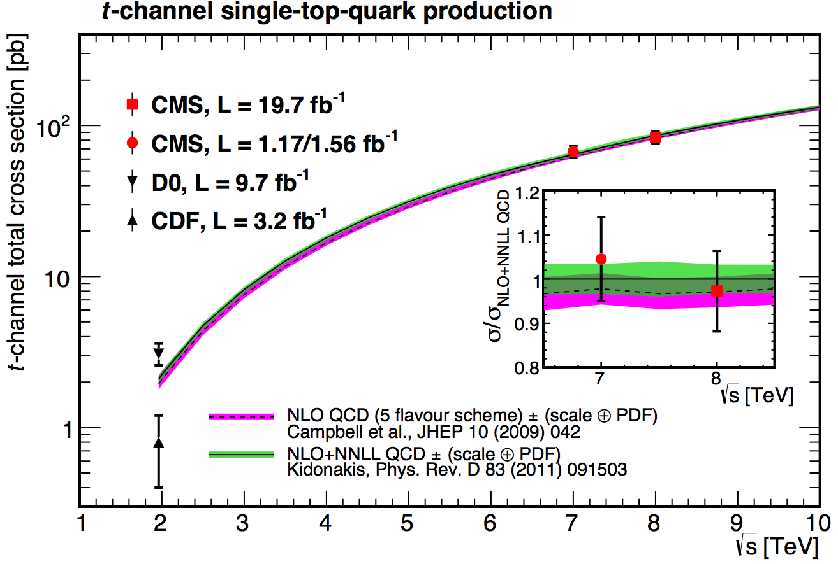
t-channel: results
7TeV | Measured | 67.2±3.7(stat)±3.0(syst)±3.5(th)±1.5(lumi) pb = 67.2±6.1 pb
 | Prediction | 63.89+2.91-2.52 (NLO, latest calculation)
8TeV | Measured | 83.6±2.3 (stat) ±7.4 (syst) pb
 | Prediction | 84.69+3.76 -3.23 (NLO, latest calculation)

Slide 16
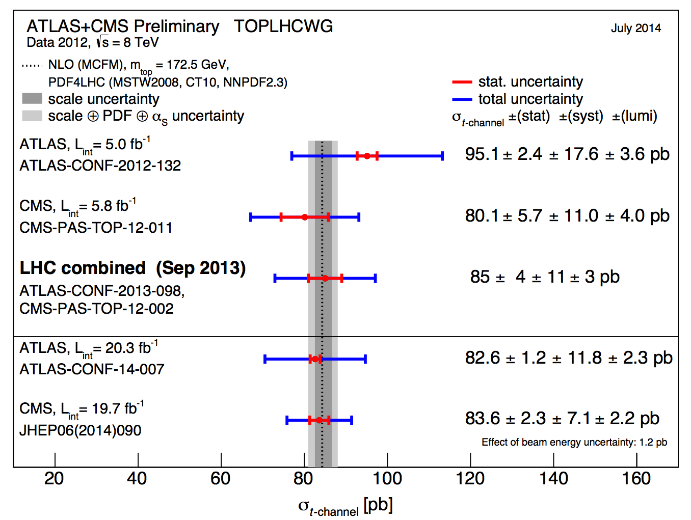
t-channel: LHC combination
At 8TeV, there was an LHC (ATLAS+CMS) combination
First LHC single top combination
Sept. 2013
CMS-PAS-TOP-12-002

Slide 17
tW associated production
Single top process with the second largest cross-section at the LHC
The final state studied is a dilepton signature
Signal events are characterized by:
Two opposite-sign, isolated leptons
Missing transverse energy (2 neutrinos in the final state)
A jet coming from a b decay
Backgrounds: ttbar (main challenge), DY

Slide 18
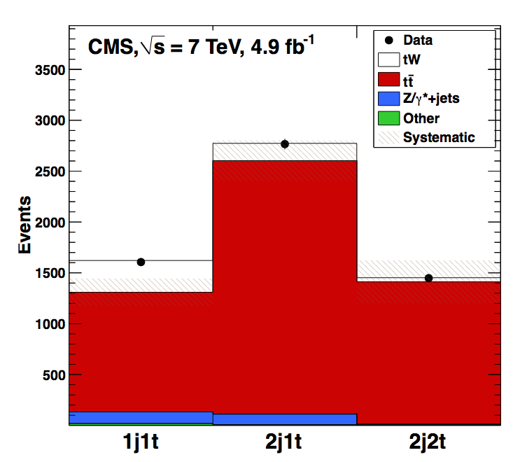
tW associated production
The low cross section of this process at the Tevatron made it impossible to study before the LHC → At the LHC is still not easy
CMS reported Evidence at 7TeV
September 2012
Phys. Rev. Lett. 110 (2013) 022003
arXiv:1209.3489
(cut, BDT) 4.0σ 7TeV - 4.9fb⁻¹

Slide 19
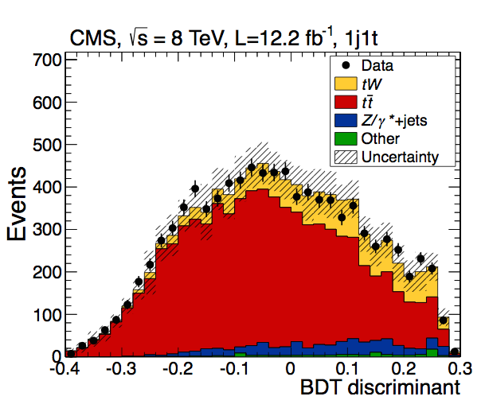
tW associated production
And discovery at 8TeV → Only observation (> 5 σ) so far
January 2014
Phys. Rev. Lett. 112 (2014) 231802
arXiv:1401.2942
(BDT, shape, cut) 6.1σ 8TeV - 12.2fb⁻¹
7 TeV → cut-based, basic BDT
8TeV → cut-based, shape-based, more sophisticated BDT
At 8TeV the analysis is already not statistically limited

Slide 20
tW associated production
The main challenge is the ttbar background
ttbar with 1 jet outside acceptance or miss-reconstructed → main background
→ Very similar final states and their diagrams mix at NLO
→ Main uncertainties come from theory modeling of ttbar
2 control regions were established
7TeV | Measured | σ_{tW} =16+5-4 pb
 | Prediction | σ_{tW} = 15.6±0.4±1.1 pb
8TeV | Measured | σ_{tW} = 23.4±5.4 pb
 | Prediction | σ_{tW} = 22.2±0.6±1.4 pb

Slide 21
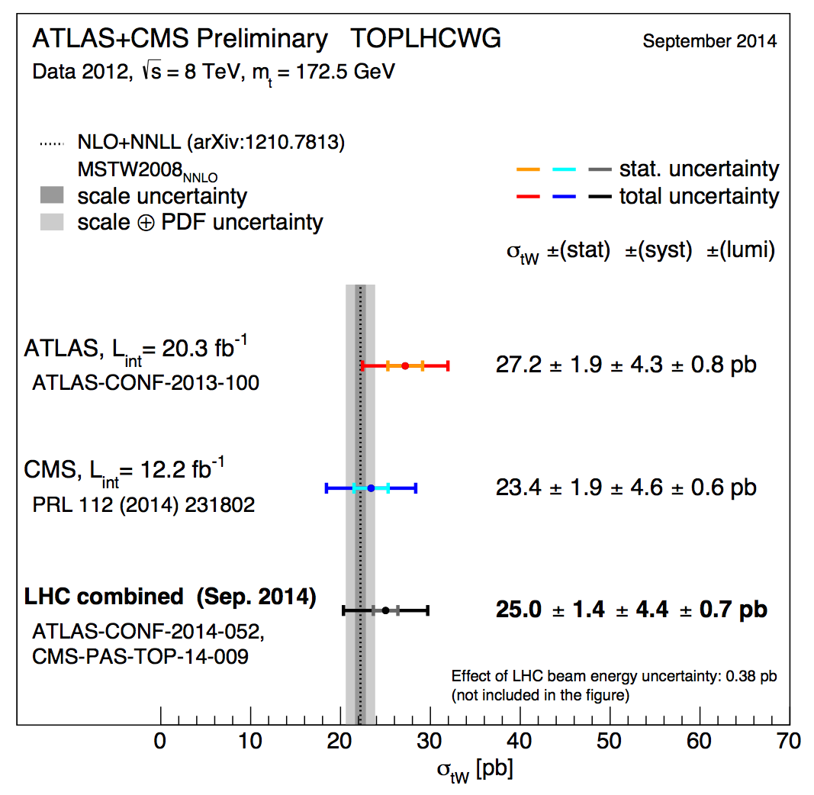
tW Combination with ATLAS
Recently, we also made public the ATLAS+CMS tW combination at 8TeV
September 2014
PAS TOP-14-009

Slide 22
s-channel
Lowest cross-section at the LHC, more important at the Tevatron (where the study of data after the shutdown allowed for the observation of the process)
Production mode sensitive to new physics: W’ bosons, charged Higgs bosons
Very challenging final state: low cross-section, difficult to separate from backgrounds
Signal signature: lepton + jets
A lepton (e,µ) and MET from the decay of a W boson
Two jets with high transverse momentum originating from b-quarks
Main backgrounds: W+jets and ttbar, multijet
Phys. Rev. Lett. 112, 231803 (2014)

Slide 23
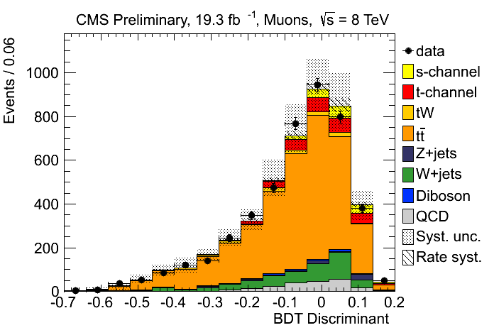
s-channel
CMS has a preliminary result at 8TeV
CMS-PAS-TOP-13-009
(November 2013)
Full lumi, e and µ
BDT
S/B is a bit better at 7TeV
In Run-2 will be even harder
σ [pb] | t-channel | tW | s-channel
LHC (7 TeV) | 63.9 | 15.7 | 4.63
LHC (8 TeV) | 84.7 | 22.2 | 5.55
LHC (13TeV) | 217 | 71.2 | 11.3
σ_{s-channel} = 6.2±5.4(exp.)±5.9(th)pb = 6.2+8.0-5.1 pb (FC)
σ^{th}_{s-channel} = 5.55 ± 0.08 (scale) ± 0.21(PDF) pb (NNLL)
Upper limit of 2.1 (3.1,1.6) times the SM

Slide 24
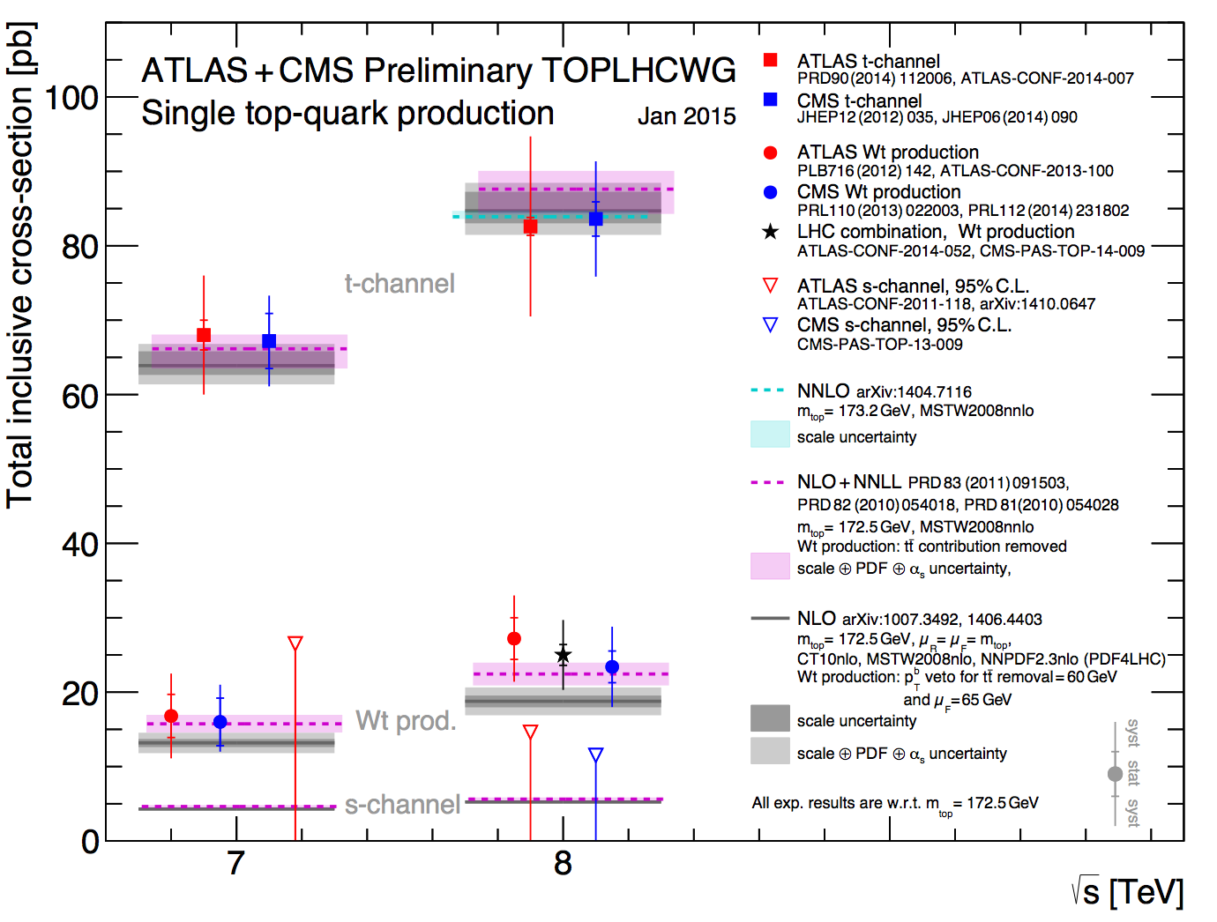
Run-1 Summary

Slide 25
Step 2
Measure SM properties in single top signatures

Slide 26

Measurements
Tevatron + LHC established the three single top modes:
Discovery era is over → Enter the Measurements age
Different SM measurements can be performed in the top sector and many have been performed already during Run-1 in CMS, mostly in ttbar
Competitive measurements since early data taking
To fully characterize the top quark and test consistency of SM predictions
The single top production at the LHC is large enough to measure
top properties
Complementary approach to ttbar
Another handle to tests potential BSM phenomena
Valuable to get the full picture

Slide 27
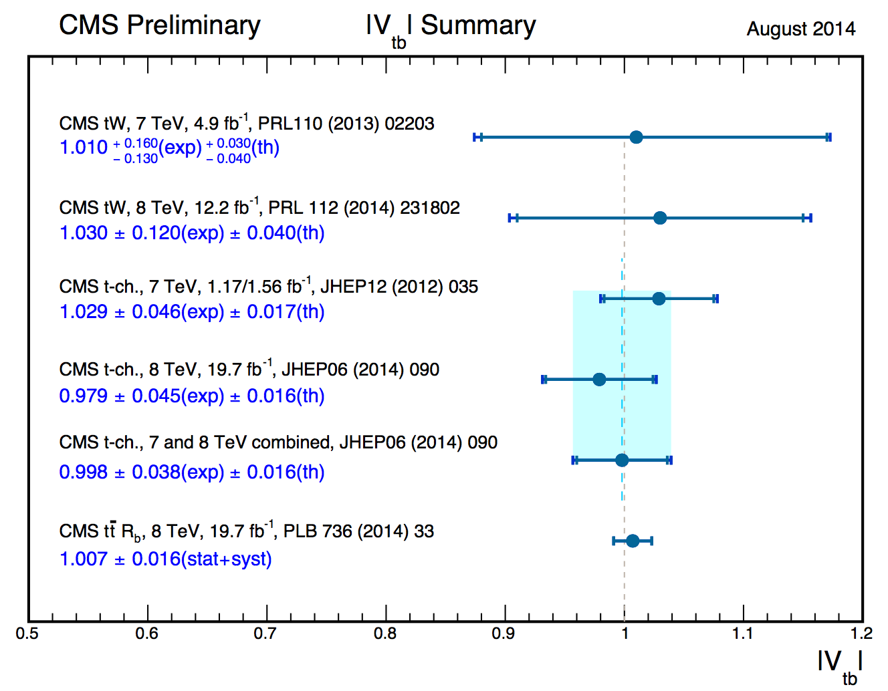
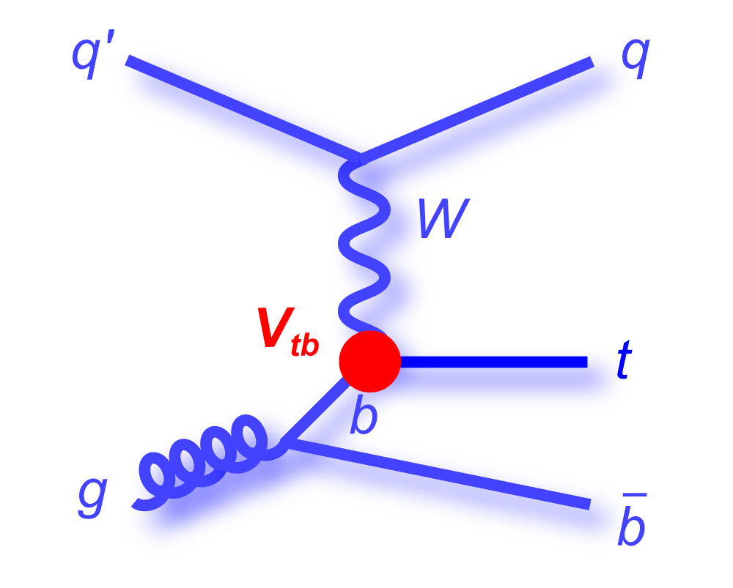
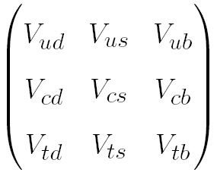
Cross-section and |V_{tb}|
From the inclusive production cross section 0f single top (t-channel, tW), a value of the CKM matrix element, |V_{tb}|, can be extracted
Considering |V_{td}|, |V_{ts}| << |V_{tb}|
Cross section ~ |V_{tb}|²

Slide 28
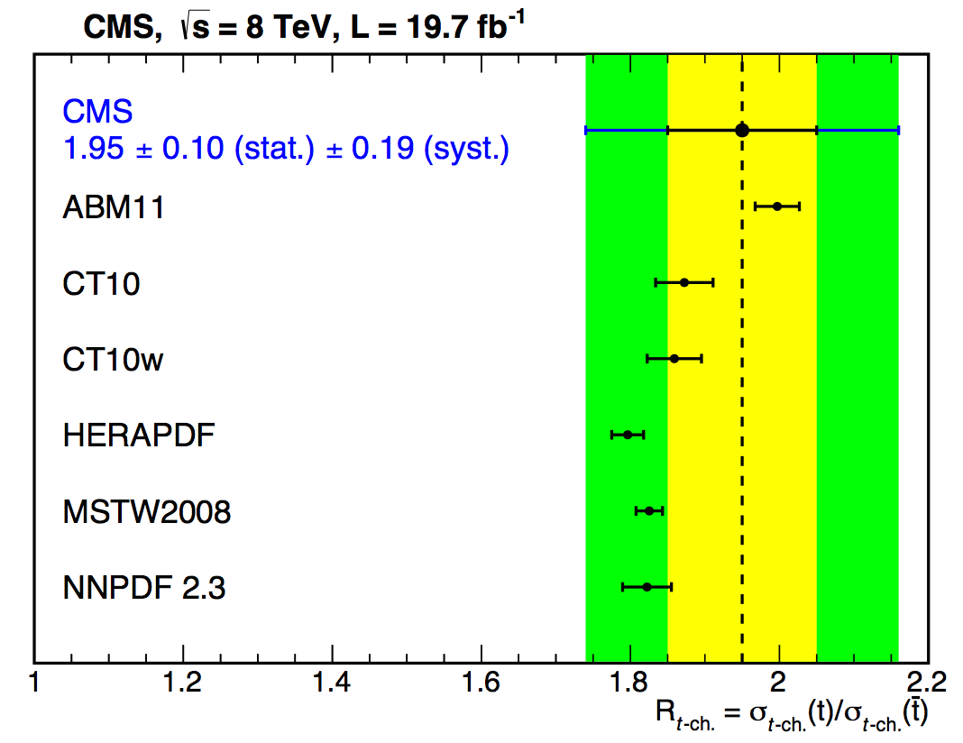
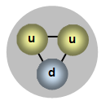
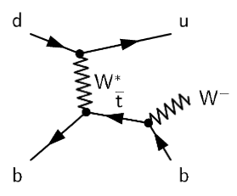
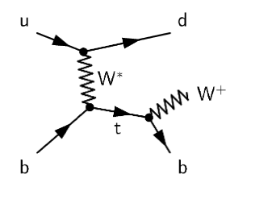
t-channel: R
Within the measurement of the t-channel cross-section at 8TeV , we measure the top/anti-top asymmetry, R
Due to the relative proportion of u and d quarks in the proton, more tops than anti-tops are expected to be produced
σ_{top} = 53.8±1.5(stat.)±4.4(syst)pb | R = 1.95±0.10(stat)±0.19(syst)
σ^{th}_{top} = 54.87 +2.29 -1.94 pb (NLO, latest calculation)
σ_{anti-top} = 27.6±1.3(stat.)±4.4(syst)pb
σ^{th}_{anti-top} = 29.74 +1.67 -1.51 pb (NLO, latest calculation)
JHEP 06 (2014) 090, arXiv:1403.7366

Slide 29
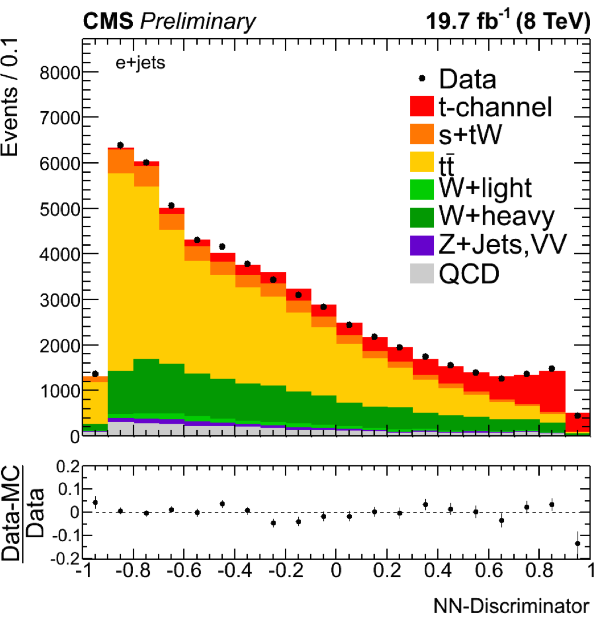
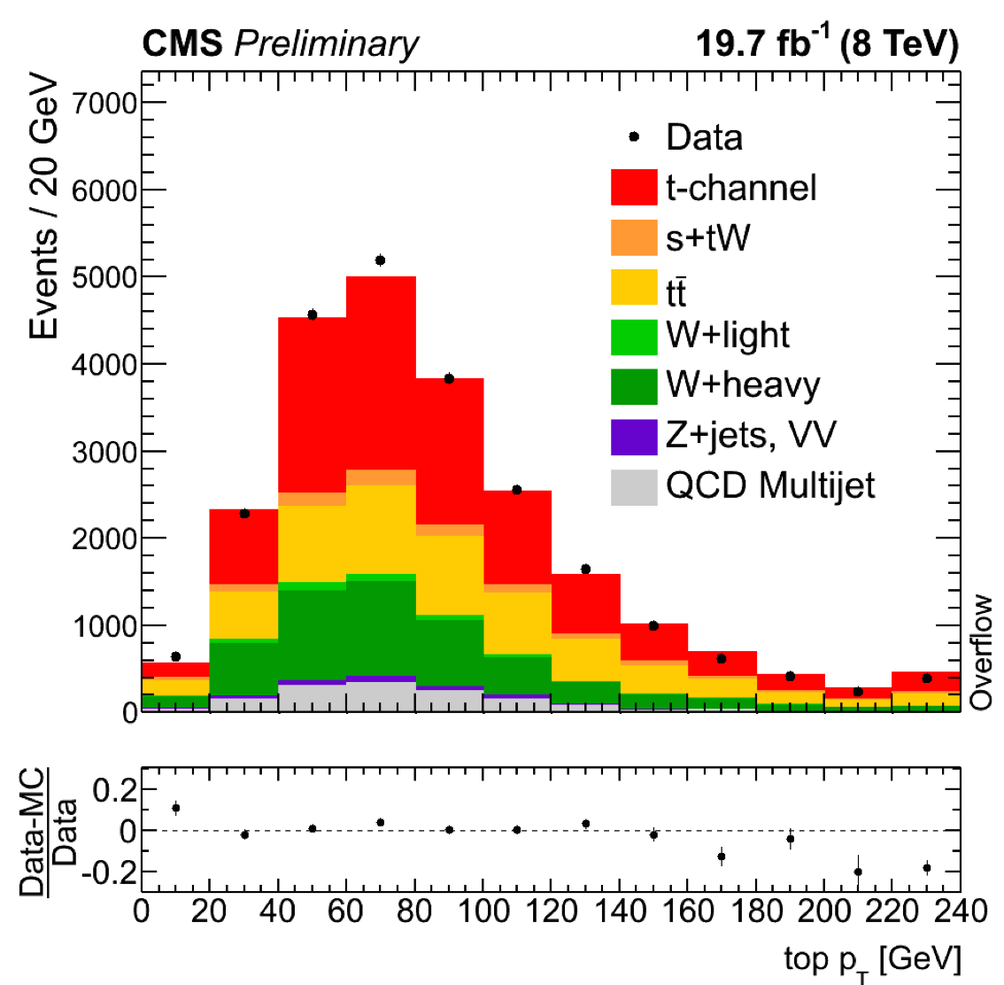
t-channel: differential x-sec
t-channel differential cross section came last September, still preliminary
8 TeV, full luminosity
Starting in the same way as the inclusive cross section, the analysis uses a NN to obtain a purer t-channel sample
September 2014
CMS PAS TOP-14-004
Events are selected by cutting on an optimal NN discriminant value

Slide 30
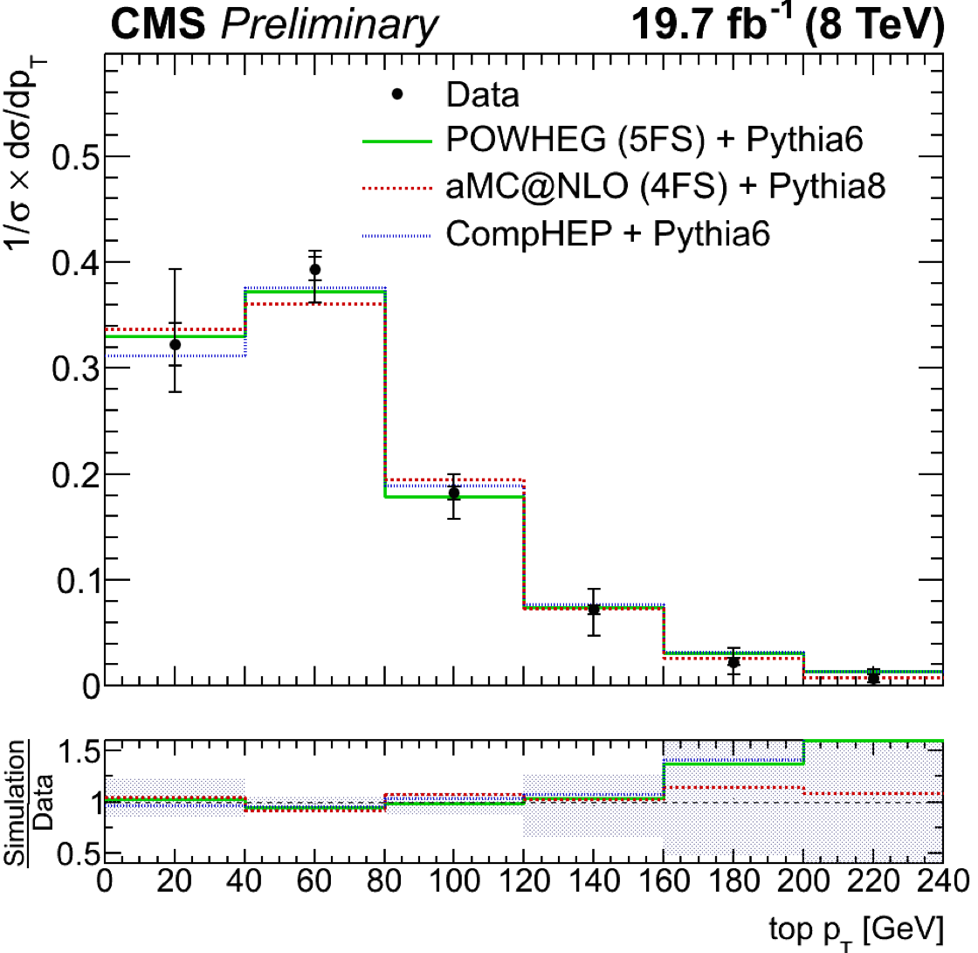
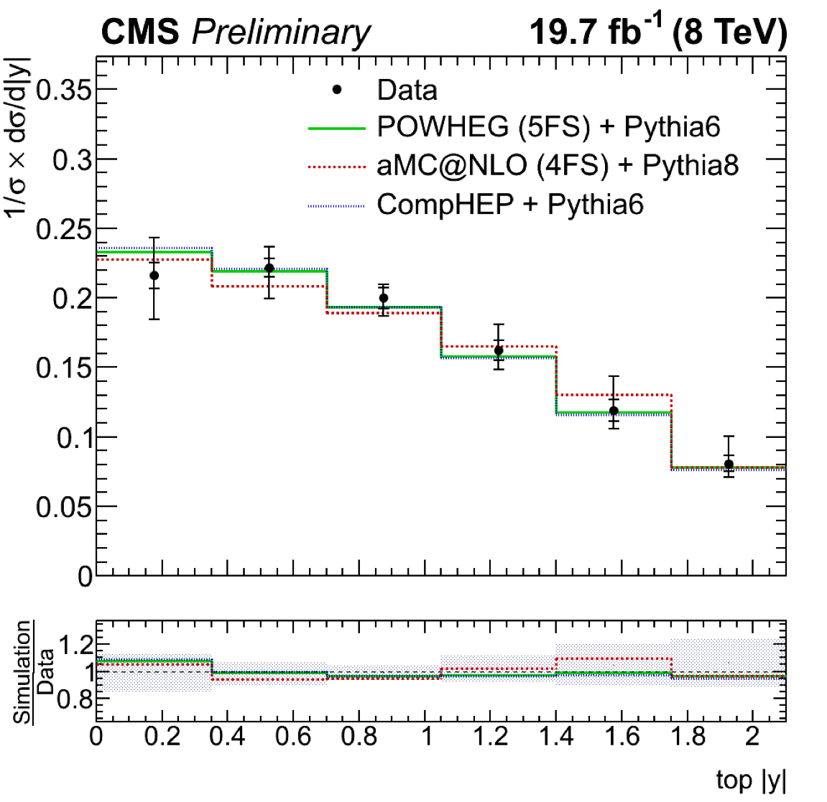
t-channel: differential x-sec
Distributions are then corrected for detector effects allowing for direct comparison with theoretical predictions (Unfolded)
p_{T} and rapidity of the top quarks compared with different predictions:
PowHeg+Pythia (solid), aMC@NLO+Pythia (dotted), and CompHEP (dashed)
CMS PAS TOP-14-004

Slide 31
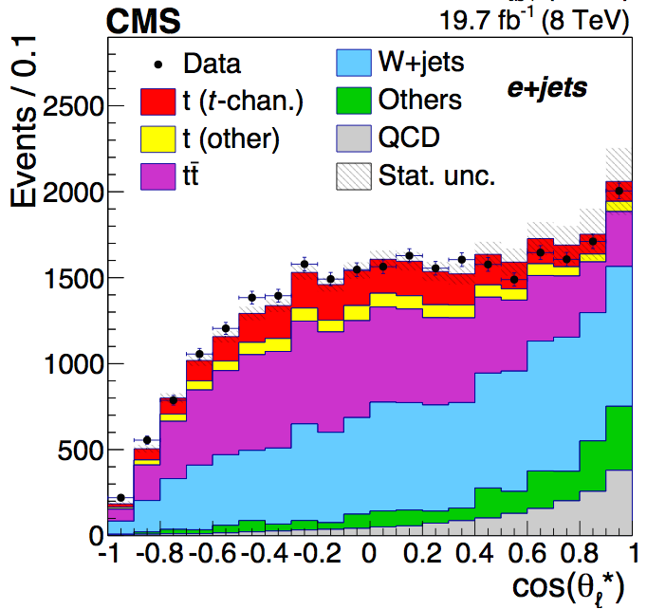
t-channel: W-helicity
Further than cross section measurements → measurement of the W-helicity fractions is the first published measurement of top properties in single top signatures at the LHC
Exact same selection and background estimation as the standard t-channel inclusive cross section measurement
θ*: angle between the W boson in the top quark rest frame and the down-type decay fermion in the W rest frame → related to the W-helicity fractions (F₀, F_{L}, F_{R})
October 2014
JHEP 01 (2015) 053, arXiv:1410.1154
W boson helicity in t-channel

Slide 32
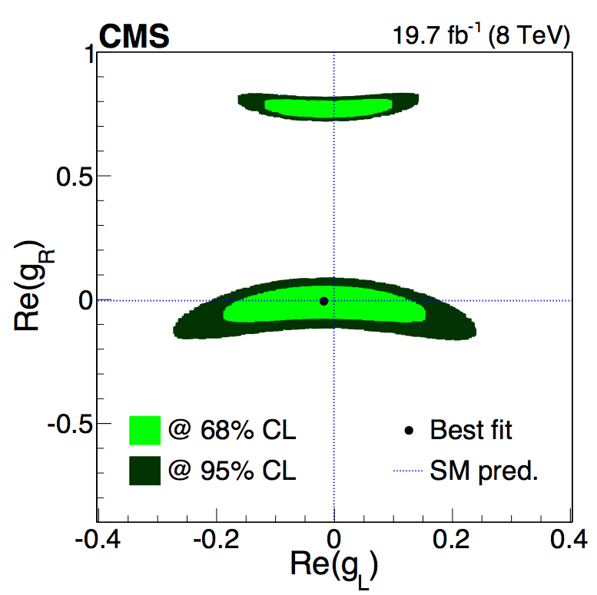
t-channel: W-helicity (II)
Theory prediction (NNLO) | Measured
F_{L} = 0.311 ± 0.005 F_{R} = 0.0017 ± 0.0001 F₀ = 0.687 ± 0.005 PRD 81, 111503(R) (2010) | F_{L} = 0.298 ± 0.028 (stat) ± 0.032 (syst) F_{R} = -0.018 ± 0.019 (stat) ± 0.011 (syst) F₀ = 0.720 ± 0.039 (stat) ± 0.037 (syst)
Using the helicity fractions measured → exclude the tensor terms of the tWb anomalous couplings, g_{L} and g_{R}
October 2014
JHEP 01 (2015) 053, arXiv:1410.1154
W boson helicity in t-channel

Slide 33
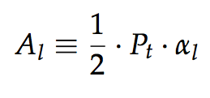
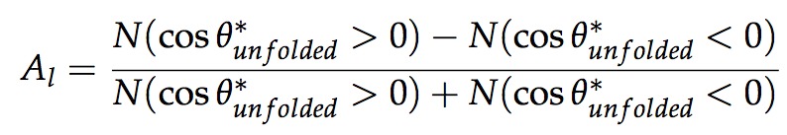
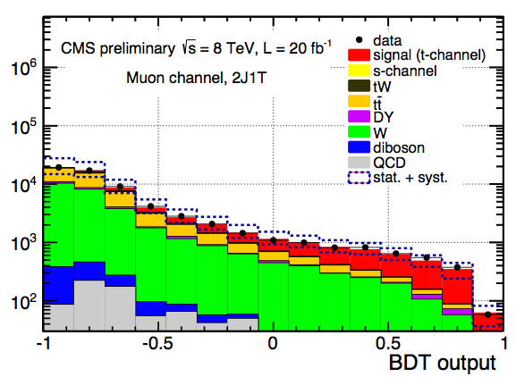
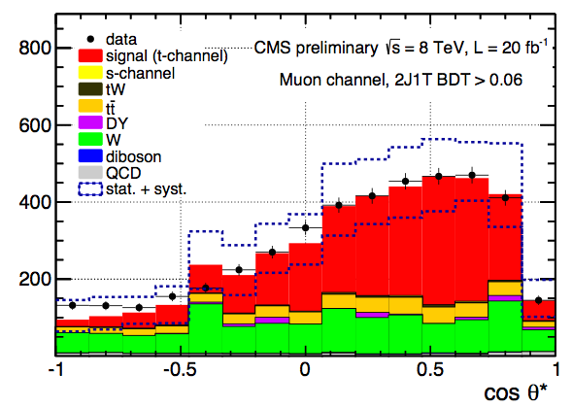
t-channel: top polarization
Single top quarks are highly polarized, spin aligned with the recoiling light jet
Polarization ~ spin asymmetry
From unfolded cosθ*_{l} distribution
A BDT is used to get a t-channel enriched sample
August 2013
CMS-PAS-TOP-13-001

Slide 34
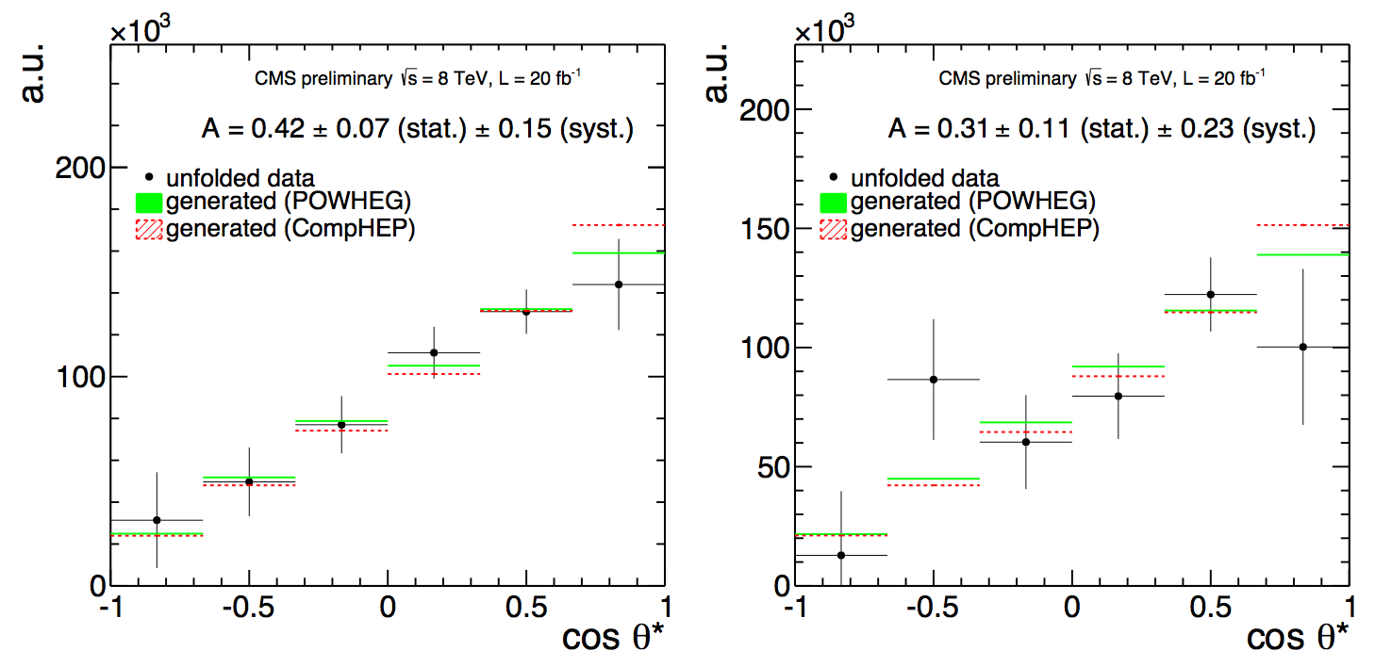
t-channel: top polarization (II)
µ
e
A_{l}=0.41±0.06(stat.)±0.16(syst.) (SM expectation 0.44)
P_{t}=0.82±0.12(stat.)±0.32(syst.)
August 2013
CMS-PAS-TOP-13-001

Slide 35
Step 3
Search for FCNC and Anomalous Couplings

Slide 36
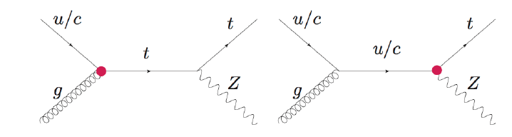
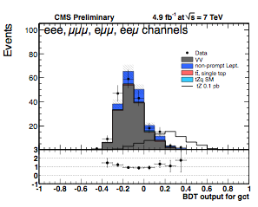
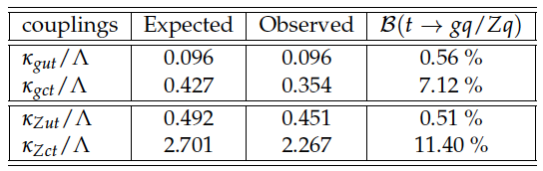
FCNC tZ
Limits on anomalous Wtb couplings can be extracted from SM measurements (W-helicity fractions, top polarization)
Dedicated analysis searching for FCNC in many single top signatures are also in place
FCNC tZ
BDT (gut, gct, Zut, Zct) 7TeV
Limits on couplings and branching fractions
Three-lepton signature
July 2013
CMS-PAS-TOP-12-021

Slide 37
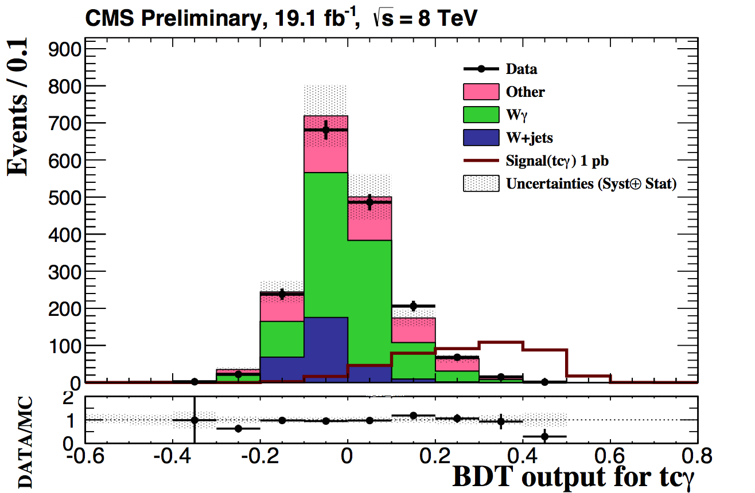
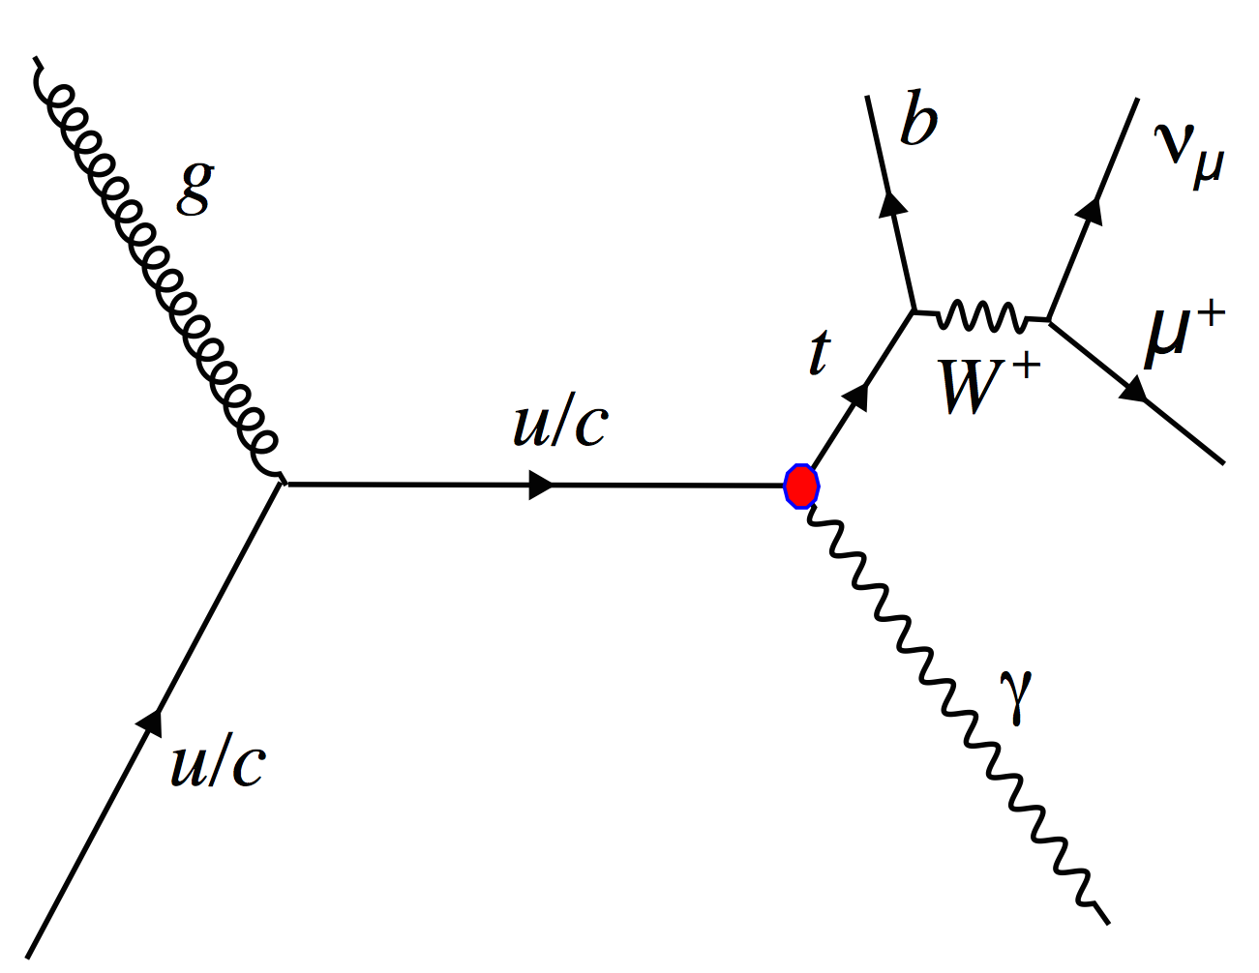
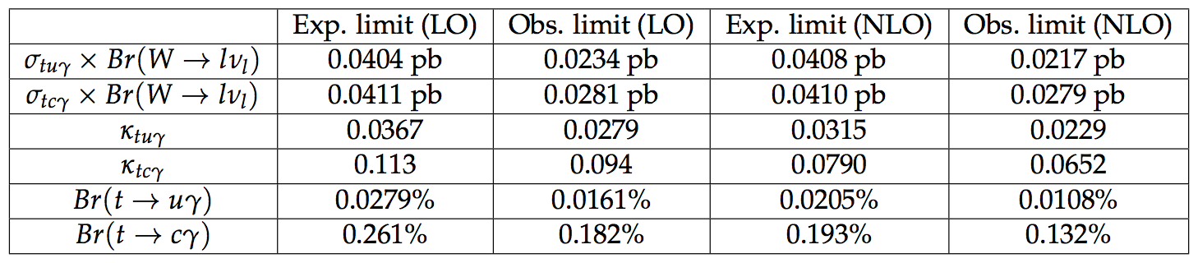
FCNC tγ
Another preliminary result from Spring last year
tqγ
tuγ, tcγ couplings
BDT 8TeV, µ
May 2014
CMS PAS-TOP-14-003

Slide 38

FCNC and AC in t-channel
It is possible to optimize an analysis to explore FCNC and anomalous couplings in t-channel directly
Another preliminary result from last Spring
FCNC in t-channel
7TeV, tcg and tug
NN using different anomalous samples to separate hypotheses
May 2014
CMS PAS-TOP-14-007

Slide 39
Step 4
Explore unusual single top signatures

Slide 40




Top+ Higgs
single top + Higgs (complementary to ttH)
tH production highly suppressed in the SM
If top Higgs Yukawa coupling is negative → enhanced
Several decays investigated, more to come, all preliminary
Need Run-2 to become sensitive
tH, H→WW
CMS PAS-HIG-14-026
(February 2015)
tH, H→γγ
CMS PAS-HIG-14-001
(March 2013)
tH, H→bb
CMS PAS-HIG-14-015
(October 2014)

Slide 41

BSM top + X
There are many other BSM channels that involve top quarks and/or similar signatures to single top:
classic example: W’→tb (arXiv:1402.2176)
Some feature truly “single” top quarks
Monotop
Dark Matter search using top + MET
arXiv:1410.1149
Accepted by PRL for publication
(October 2014)

Slide 42
Next steps?

Slide 43
Run-2
There are still open topics still to be explored by CMS with Run-1
Top mass in single top signatures, fiducial cross sections...
Run-2 will start late Spring 2015 → Will run ~3 years [300fb⁻¹ at 13 (14) TeV]
t-channel: Has become a SM candle (early analysis~1fb⁻¹ )
tW and tt interplay → Run-2 goal
With higher luminosity and center of mass energies
Work on systematics and modeling
Face new challenges (high pileup)
Moving towards “precision” era
Rare SM processes accesible (SM tZq and tγq)
More BSM channels to explore
New approaches: Single top in heavy ions! (?) arXiv:1502.04875

Slide 44
Summary
Single top signatures were very rare and largely unknown until recently
In less than 10 years we have made incredible progress
→ the LHC is extremely powerful for top, and single top in particular
In CMS we have studied the three main production modes:
t-channel
tW associated production
s-channel
We have so many single top quarks produced via t-channel that we can use them to make measurements:
W-helicity fractions, top polarization, |Vtb|…
We have used conventional and rare single top production modes to look for FCNC and Anomalous Couplings
We have starting the exploration of more exotic single top processes looking for new phenomena
Run-2 will be the time to fully explore single top signatures, in particular to look for physics beyond the standard model

